Slide 1

IMDB Movie Analysis
Ayush Saxena

Slide 2

Project Description
In this Project, the data is all about the IMDB movie information, in this data we have columns such as actor names, movie titles, years, and many more. In order to analyze the data, we also have audience ratings and movie reviews. In this project, we will use all this information and extract meaningful insights with the help of excel and complete the statistics conclusion. (Techstack – Microsoft Excel)
Approach
I carefully walk through the raw data and then analyze the data what data is and then I switch my approach that which column has which type of information after that, I walk through the team requirement question and think about it, Then I remove all the null values and duplicate values from the data then I worked on it by applying suitable aggregation.

Slide 3
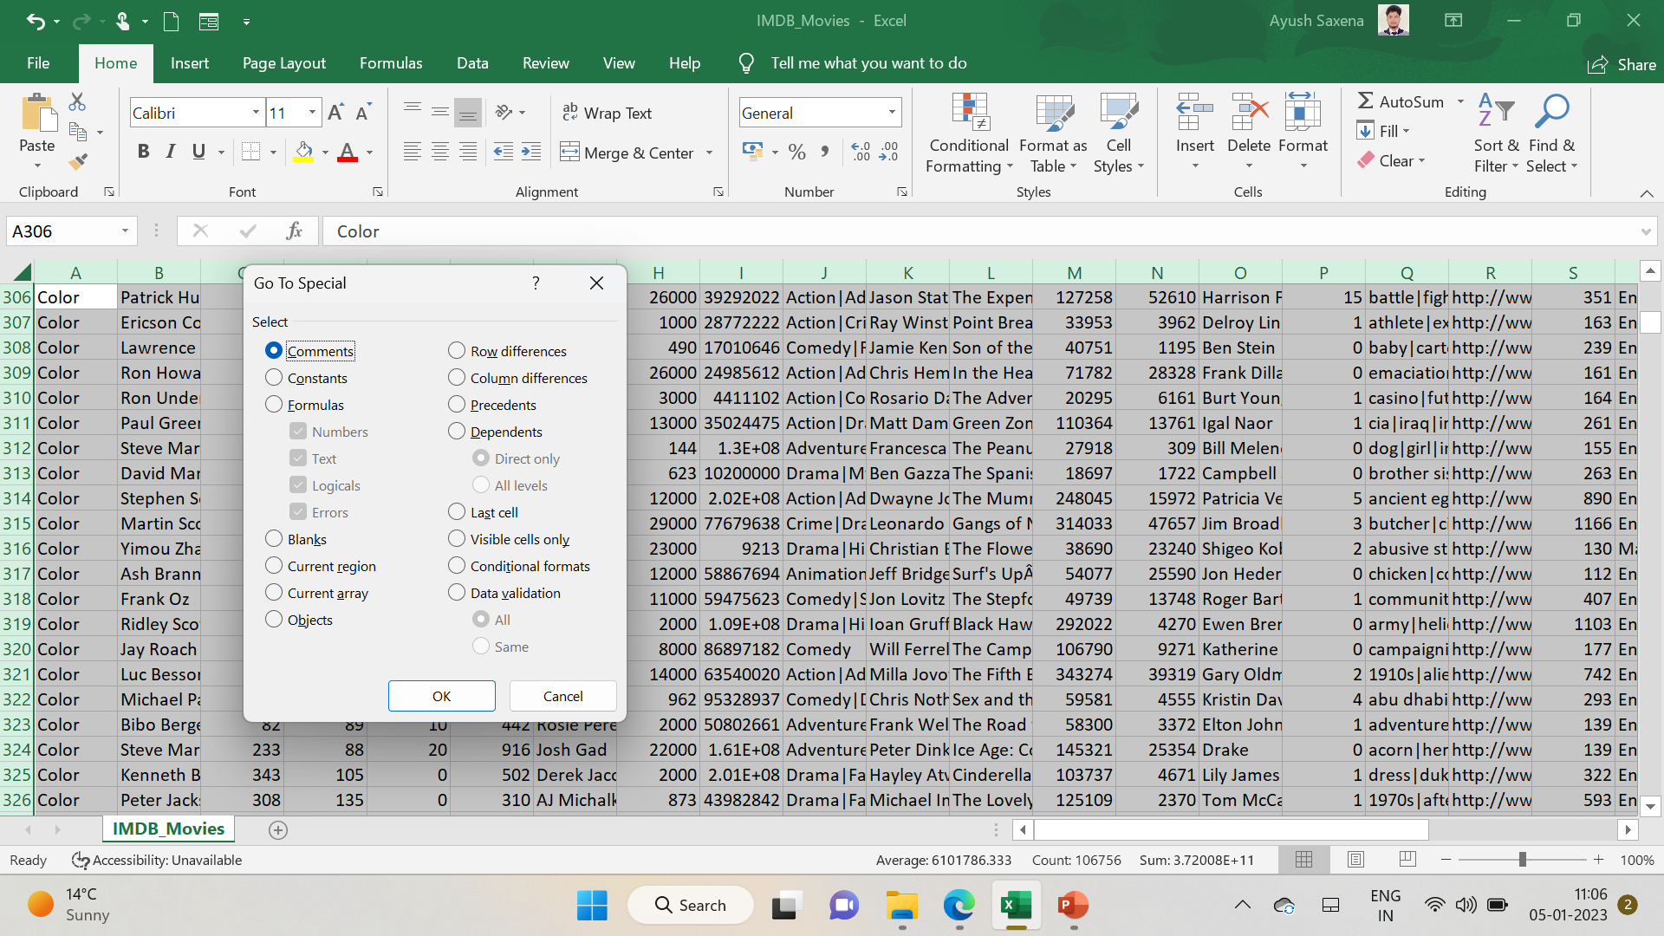
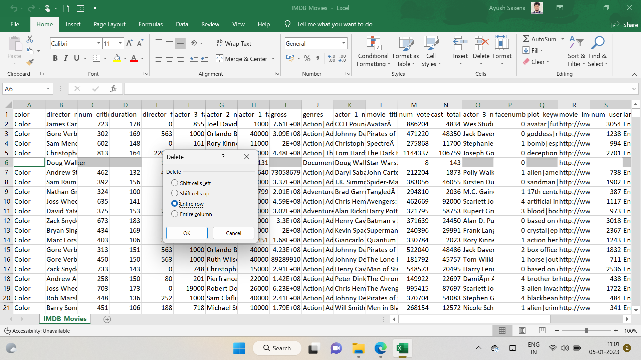
A. Cleaning of the data:: This is one of the most important steps to perform before moving forward with the analysis. Use your knowledge learned till now to do this. (Dropping columns, removing null values, etc.) Your task: Clean the data
Removing the null Values By selecting all data then choose the Find and select option then go to special then choose black then click ok by this we have selected the null row then delete the entire row firstly we have 5044 rows but after removing the null values now we the have remaining 3816 rows.
Class | Group 1 | Group 2
Class 1 | 82 | 95
Class 2 | 76 | 88
Class 3 | 84 | 90

Slide 4
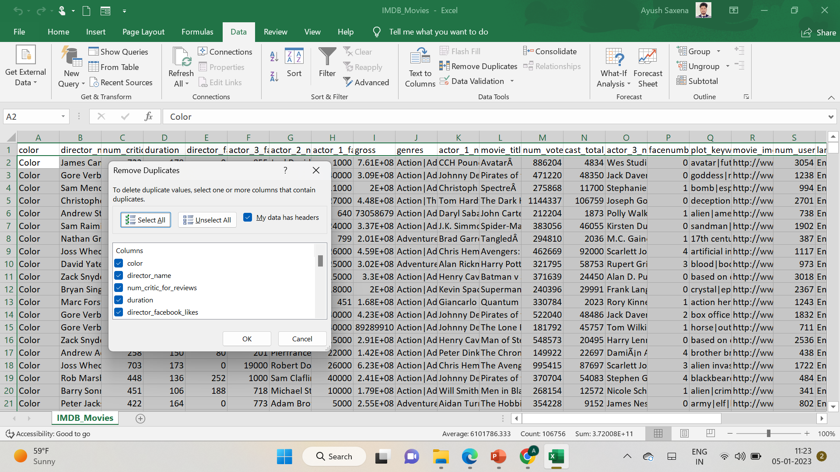
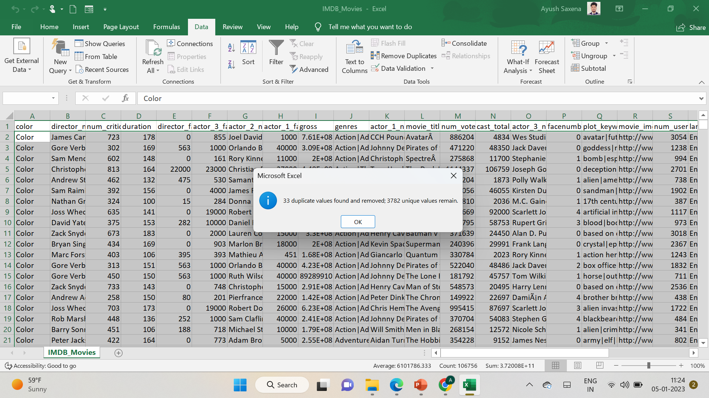
Cleaning of the data Removing the duplicate Values from the table

Slide 5
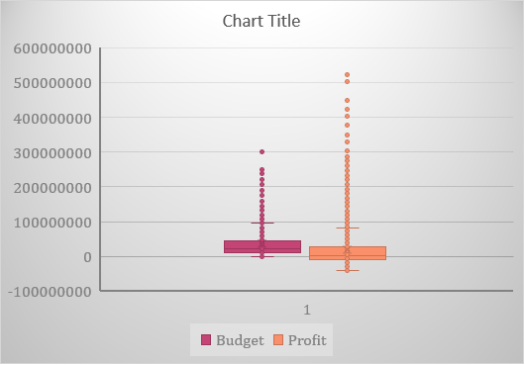
B. Movies with the highest profit: Create a new column called profit which contains the difference between the two columns: gross and budget. Sort the column using the profit column as a reference. Plot profit (y-axis) vs budget (x-axis) and observe the outliers using the appropriate chart type. Your task: Find the movies with the highest profit. Avatar Is the movie with the highest profit

Slide 6
C. Top 250: Create a new column IMDb_Top_250 and store the top 250 movies with the highest IMDb Rating (corresponding to the column: imdb_score). Also make sure that for all of these movies, the num_voted_users is greater than 25,000. Also, add a Rank column containing the values 1 to 250 indicating the ranks of the corresponding films. Extract all the movies in the IMDb_Top_250 column which are not in the English language and store them in a new column named Top_Foreign_Lang_Film. You can use your own imagination also! Your task: Find IMDB Top 250

Slide 7
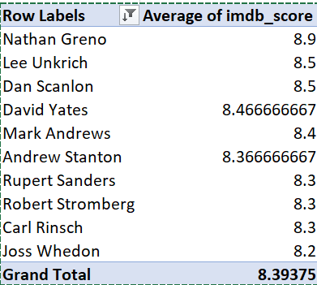
D. Best Directors: Group the column using the director_name column. Find out the top 10 directors for whom the mean of imdb_score is the highest and store them in a new column top10director. In case of a tie in IMDb score between two directors, sort them alphabetically. Your task: Find the best directors

Slide 8
E. Popular Genres: Perform this step using the knowledge gained while performing previous steps. Your task: Find popular genres

Slide 9
F. Charts: Create three new columns namely, Meryl_Streep, Leo_Caprio, and Brad_Pitt which contain the movies in which the actors: 'Meryl Streep', 'Leonardo DiCaprio', and 'Brad Pitt' are the lead actors. Use only the actor_1_name column for extraction. Also, make sure that you use the names 'Meryl Streep', 'Leonardo DiCaprio', and 'Brad Pitt' for the said extraction. Append the rows of all these columns and store them in a new column named Combined. Group the combined column using the actor_1_name column. Find the mean of the num_critic_for_reviews and num_users_for_review and identify the actors which have the highest mean. Observe the change in the number of voted users over decades using a bar chart. Create a column called decade which represents the decade to which every movie belongs. For example, the title_year year 1923, 1925 should be stored as the 1920s. Sort the column based on the column decade, group it by decade, and find the sum of users who voted in each decade. Store this in a new data frame called df_by_decade. Your task: Find the critic-favorite and audience-favorite actors

Slide 10
Results
As a result, we successfully extracted meaningful data and some of the important questions as we learned about the cleaning of data and drawing some graphs, This project helped me a lot to enhance my excel knowledge and implementation of various graphs on data.

